Slide 1

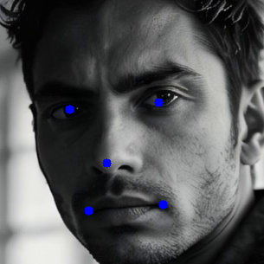

Face and facial landmarks extraction
Face and facial landmarks extraction

